Slide 1
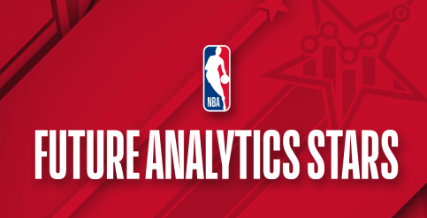

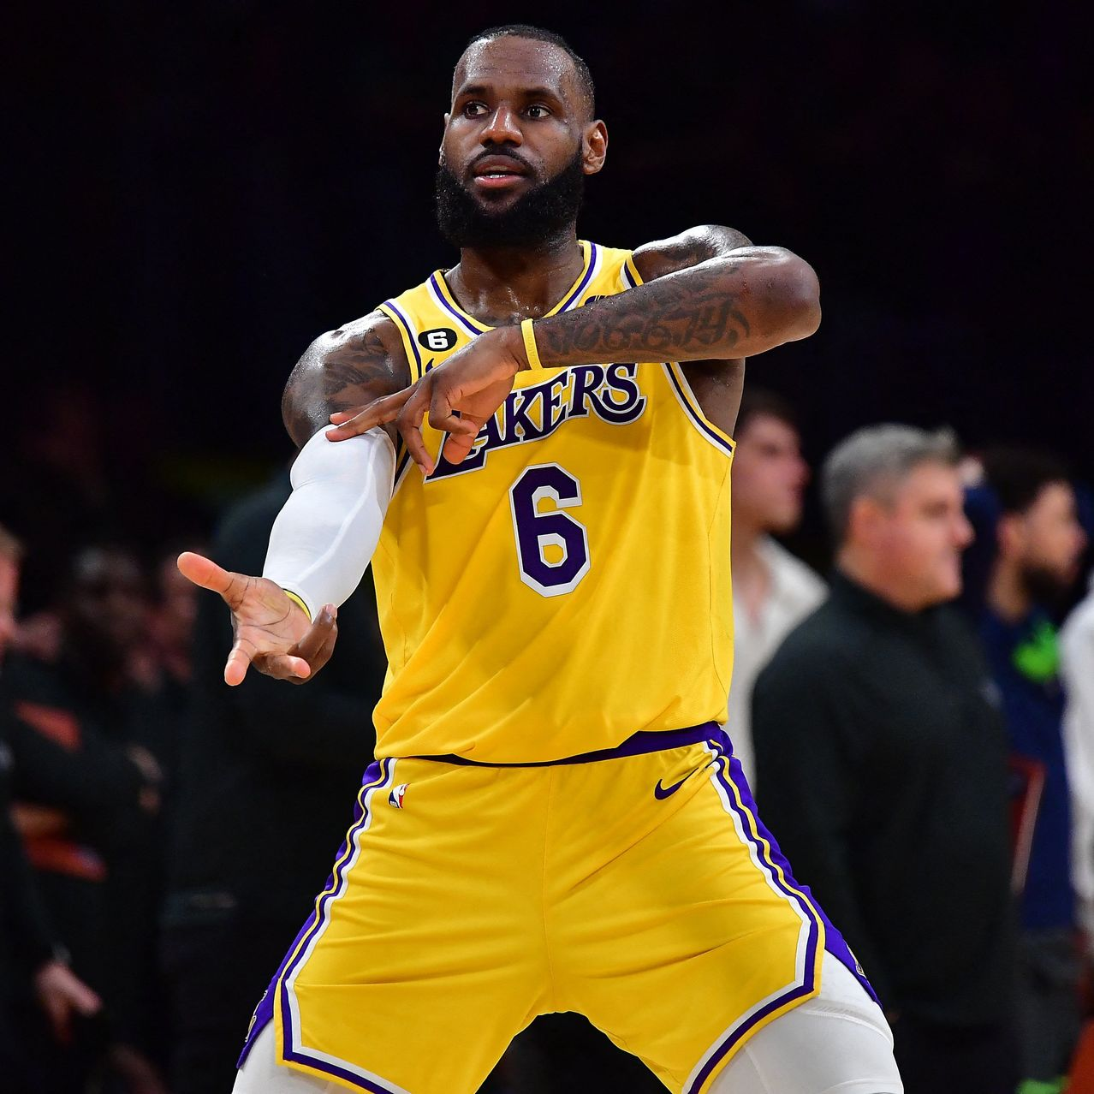
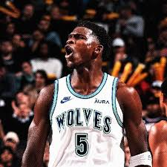
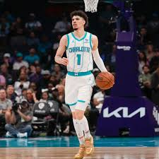
NBA FAS Capstone
ABEL LULA
PAUL ZHAO
CHRISTINA LI
Notes:
https://chapman.zoom.us/j/98927182015

Slide 2
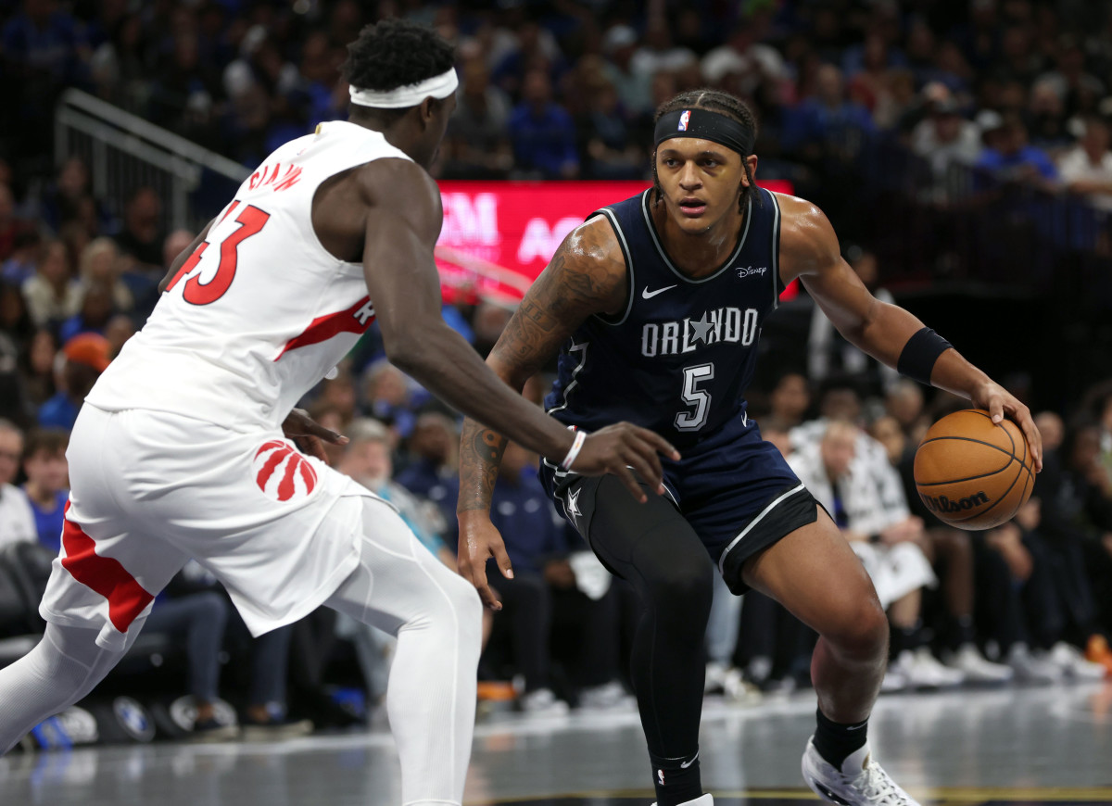
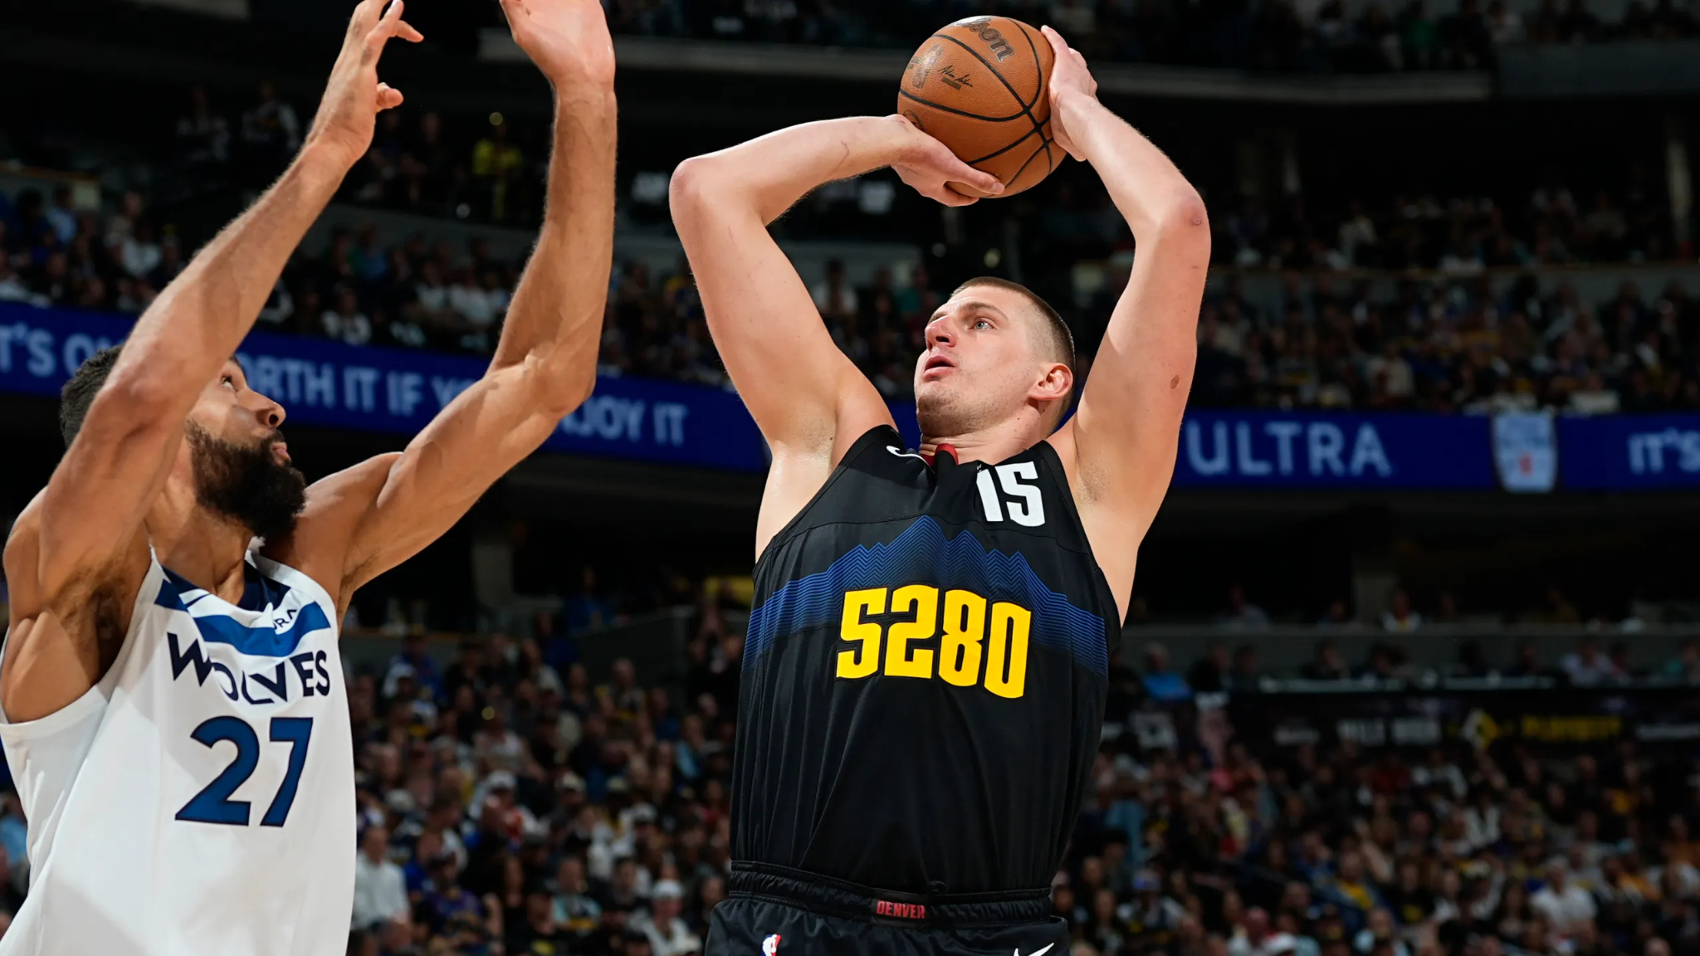
Novel Tracking Metric: Defensive Attention Index (DAI)
DAI: # of players drawn by ball handler / possessions
“At each time-stamp”
Inspiration: Emerging Era of Offense
Average points scored per game = 115.6 (highest since the 1970)
Offensive Progression > Defensive Progression
Prioritize Defense through DAI
Offensive metric to prepare defensive strategies
General Manager & Coach insight
Trade/Draft notes

Slide 3
Strategic Process
DATA VISUALIZATIONS
Develop intuitive visualizations to effectively communicate findings
RESEARCH
Research existing player metrics to identify gaps and opportunities in need and available data sets
EXTRAPOLATE FINDINGS
Derive meaningful insights from the calculated metrics.
DATA PROCESSING
Integrate and process multiple data sources to ensure inclusion of all necessary fields for analysis.
FUNCTION DEVELOPMENT
Build and implement functions to calculate DAI.

Slide 4

Function Definition & Data Handling
Calculating Distance & Active Defenders
Joined tracking & events data
Leveraged coordinate data to calculate distance between handler & defender @ each timestamp
Removed certain events, due to duplicate timestamp
Rebounds get counted as two events under the same timestamp (“REBOUND” and “TOUCH”)
Only “TOUCH” is counted
Active defender must be within 6ft of ball handler
Calculated the sum of active defenders drawn per game
Calculating Number of Possessions
Joined tracking with possessions
Calculated number of total possessions for each player.
Condition was minimum 20 possessions.
Calculating DAI
Joined total defenders drawn & total # of possessions with player name & game ID
New DAI column (# defenders drawn / # of total possessions)
< 6 ft

Slide 5
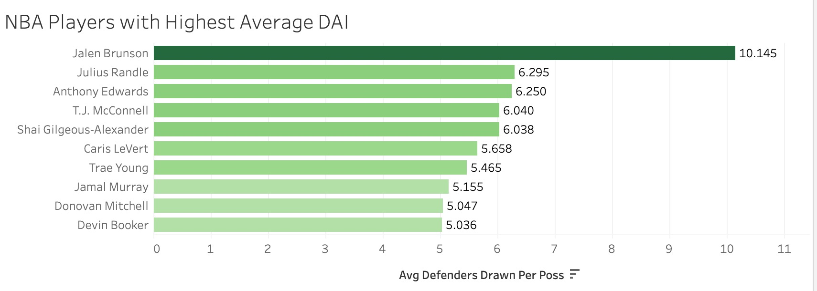
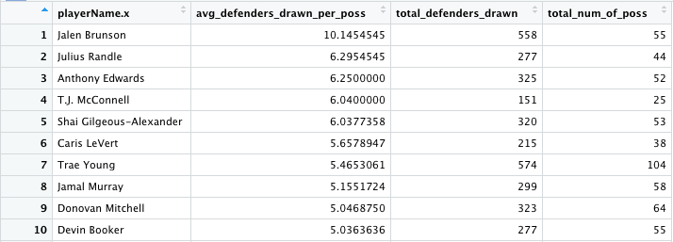

Slide 6
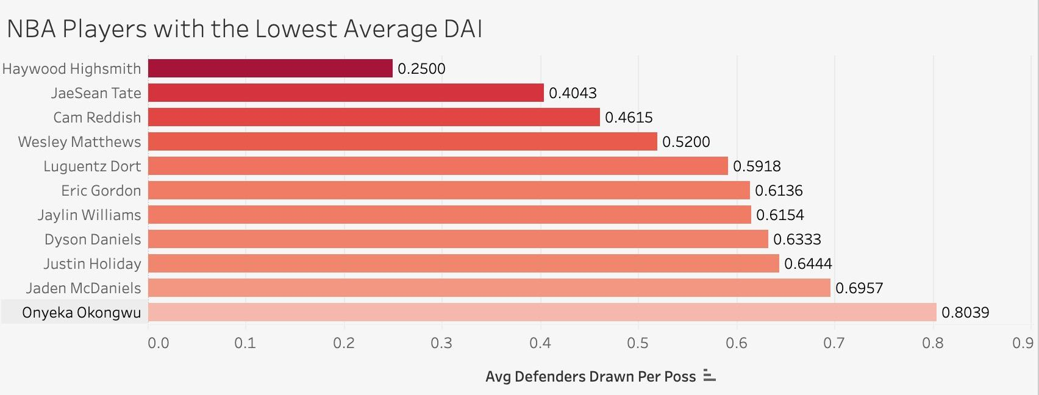
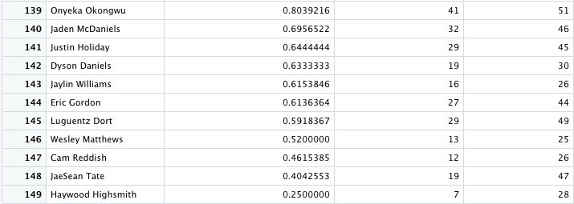

Slide 7
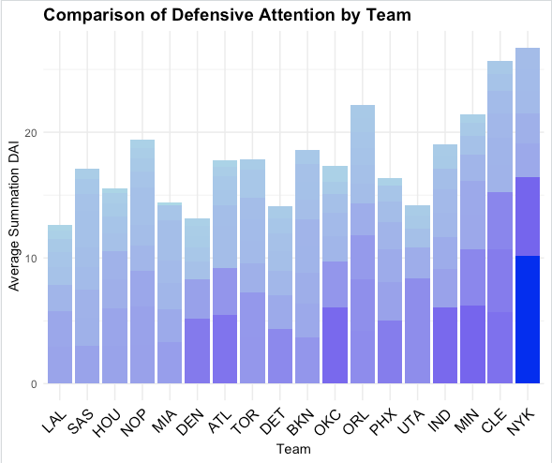
Teams that engage more players defensively
New York Knicks lead teams in DAI
Cleveland, Orlando, Minnesota
Teams that engage less players defensively
Los Angeles Lakers came last in DAI
Denver, Utah, Detroit
Players with higher/lower DAI -> darker/lighter gradients
Jalen Brunson (NYK): 10.145 (highest)
Haywood Highsmith (MIA): 0.25 (lowest)
Applications
Reinforce defensive emphasis
Classification (pass-first, iso, slow/fast, etc.)

Slide 8
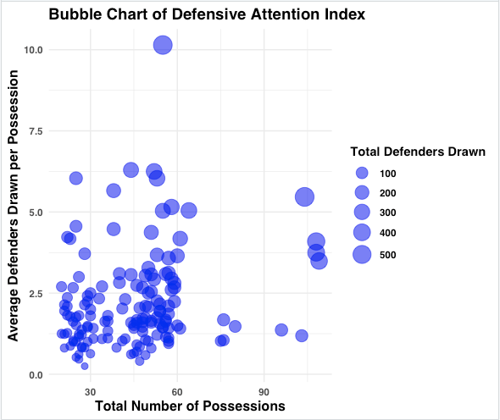
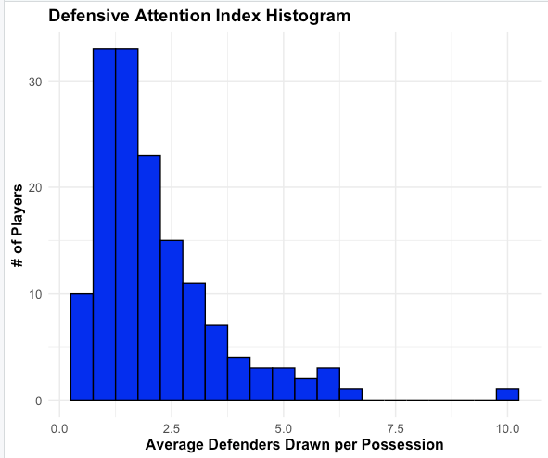

Slide 9
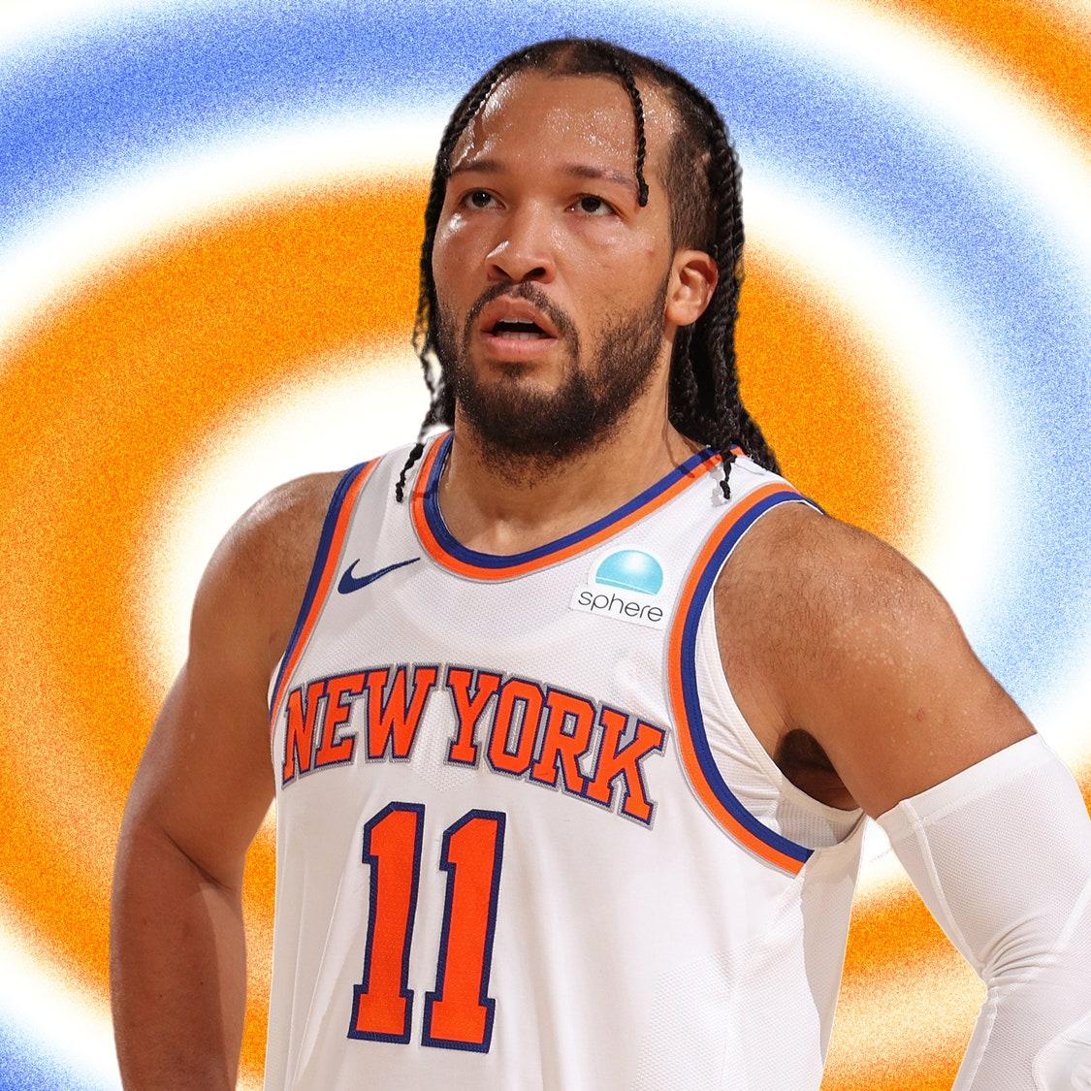
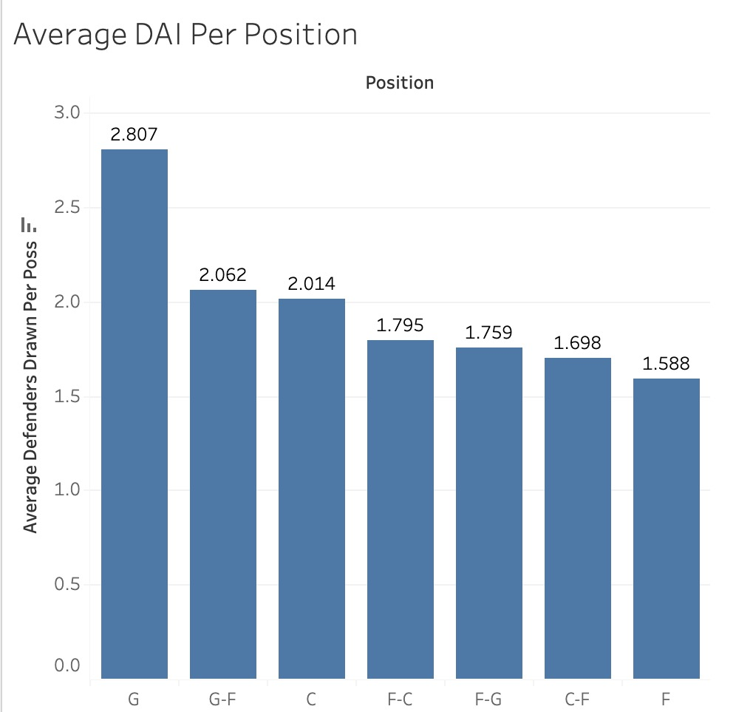

Slide 10
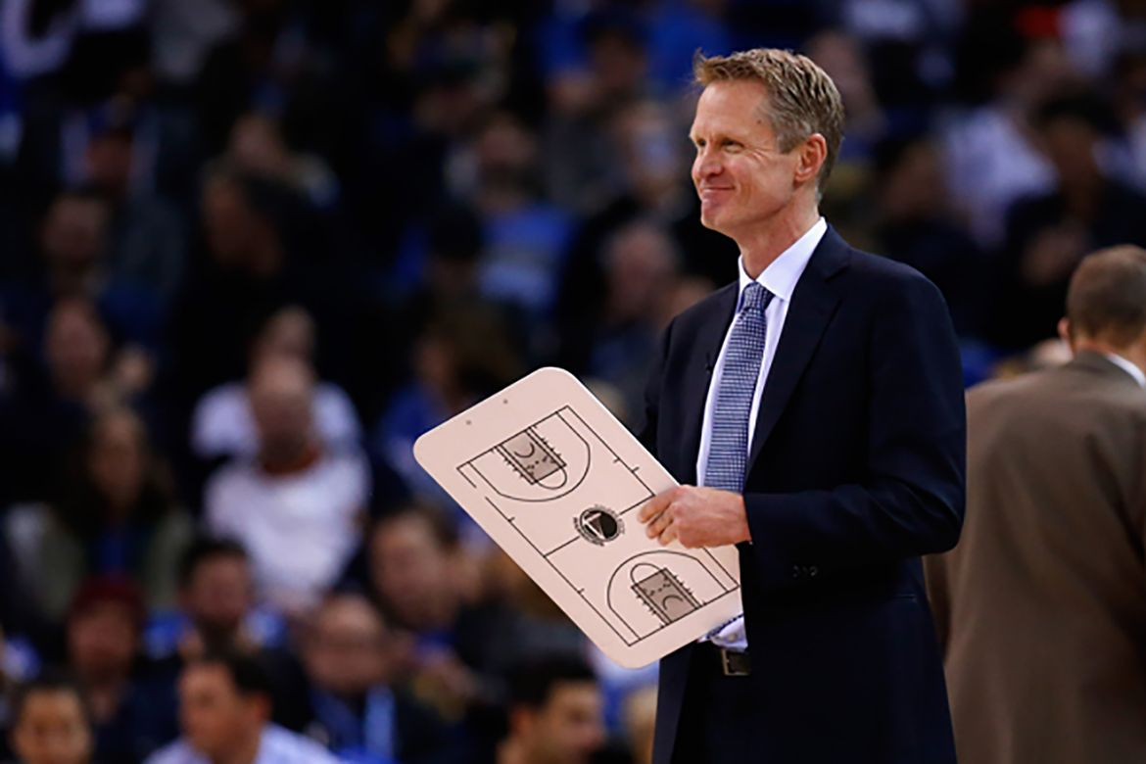
Recap/Future Applications
Build offensive/defensive strategies
Cater against specific teams
Player Evaluation & Scouting Metric
Review players’ defensive effectiveness
Post-game Performance Analysis
Adjust substitution patterns
Take advantage of mis-matches

